Slide 1



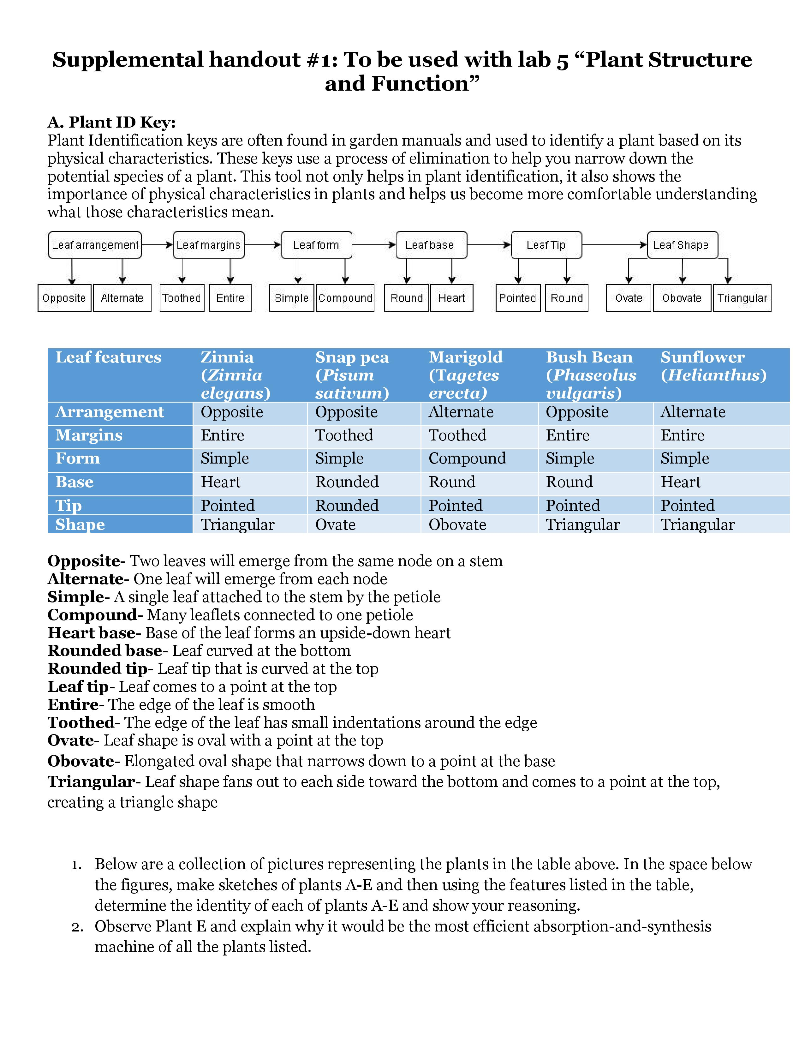
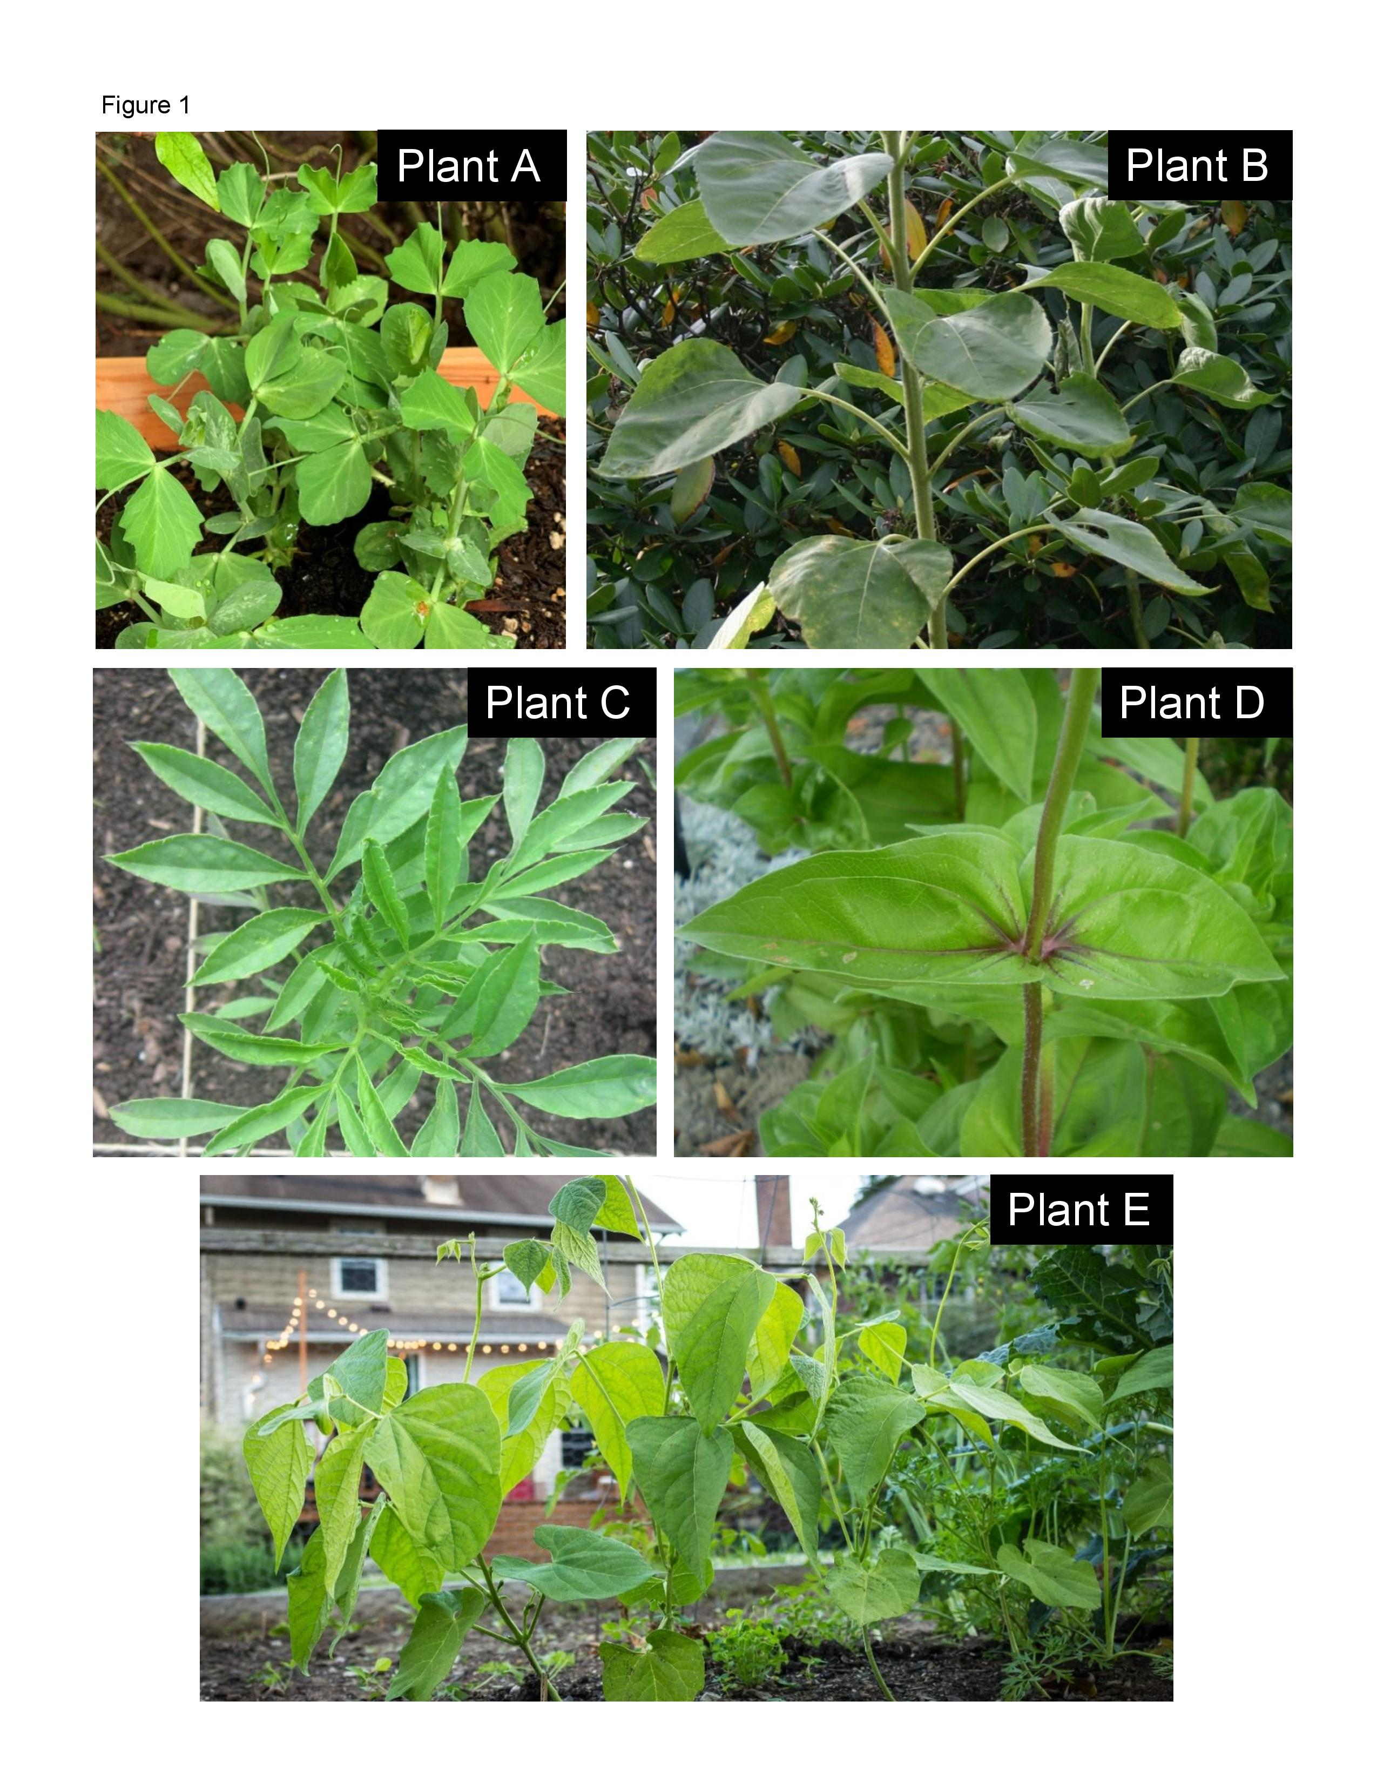


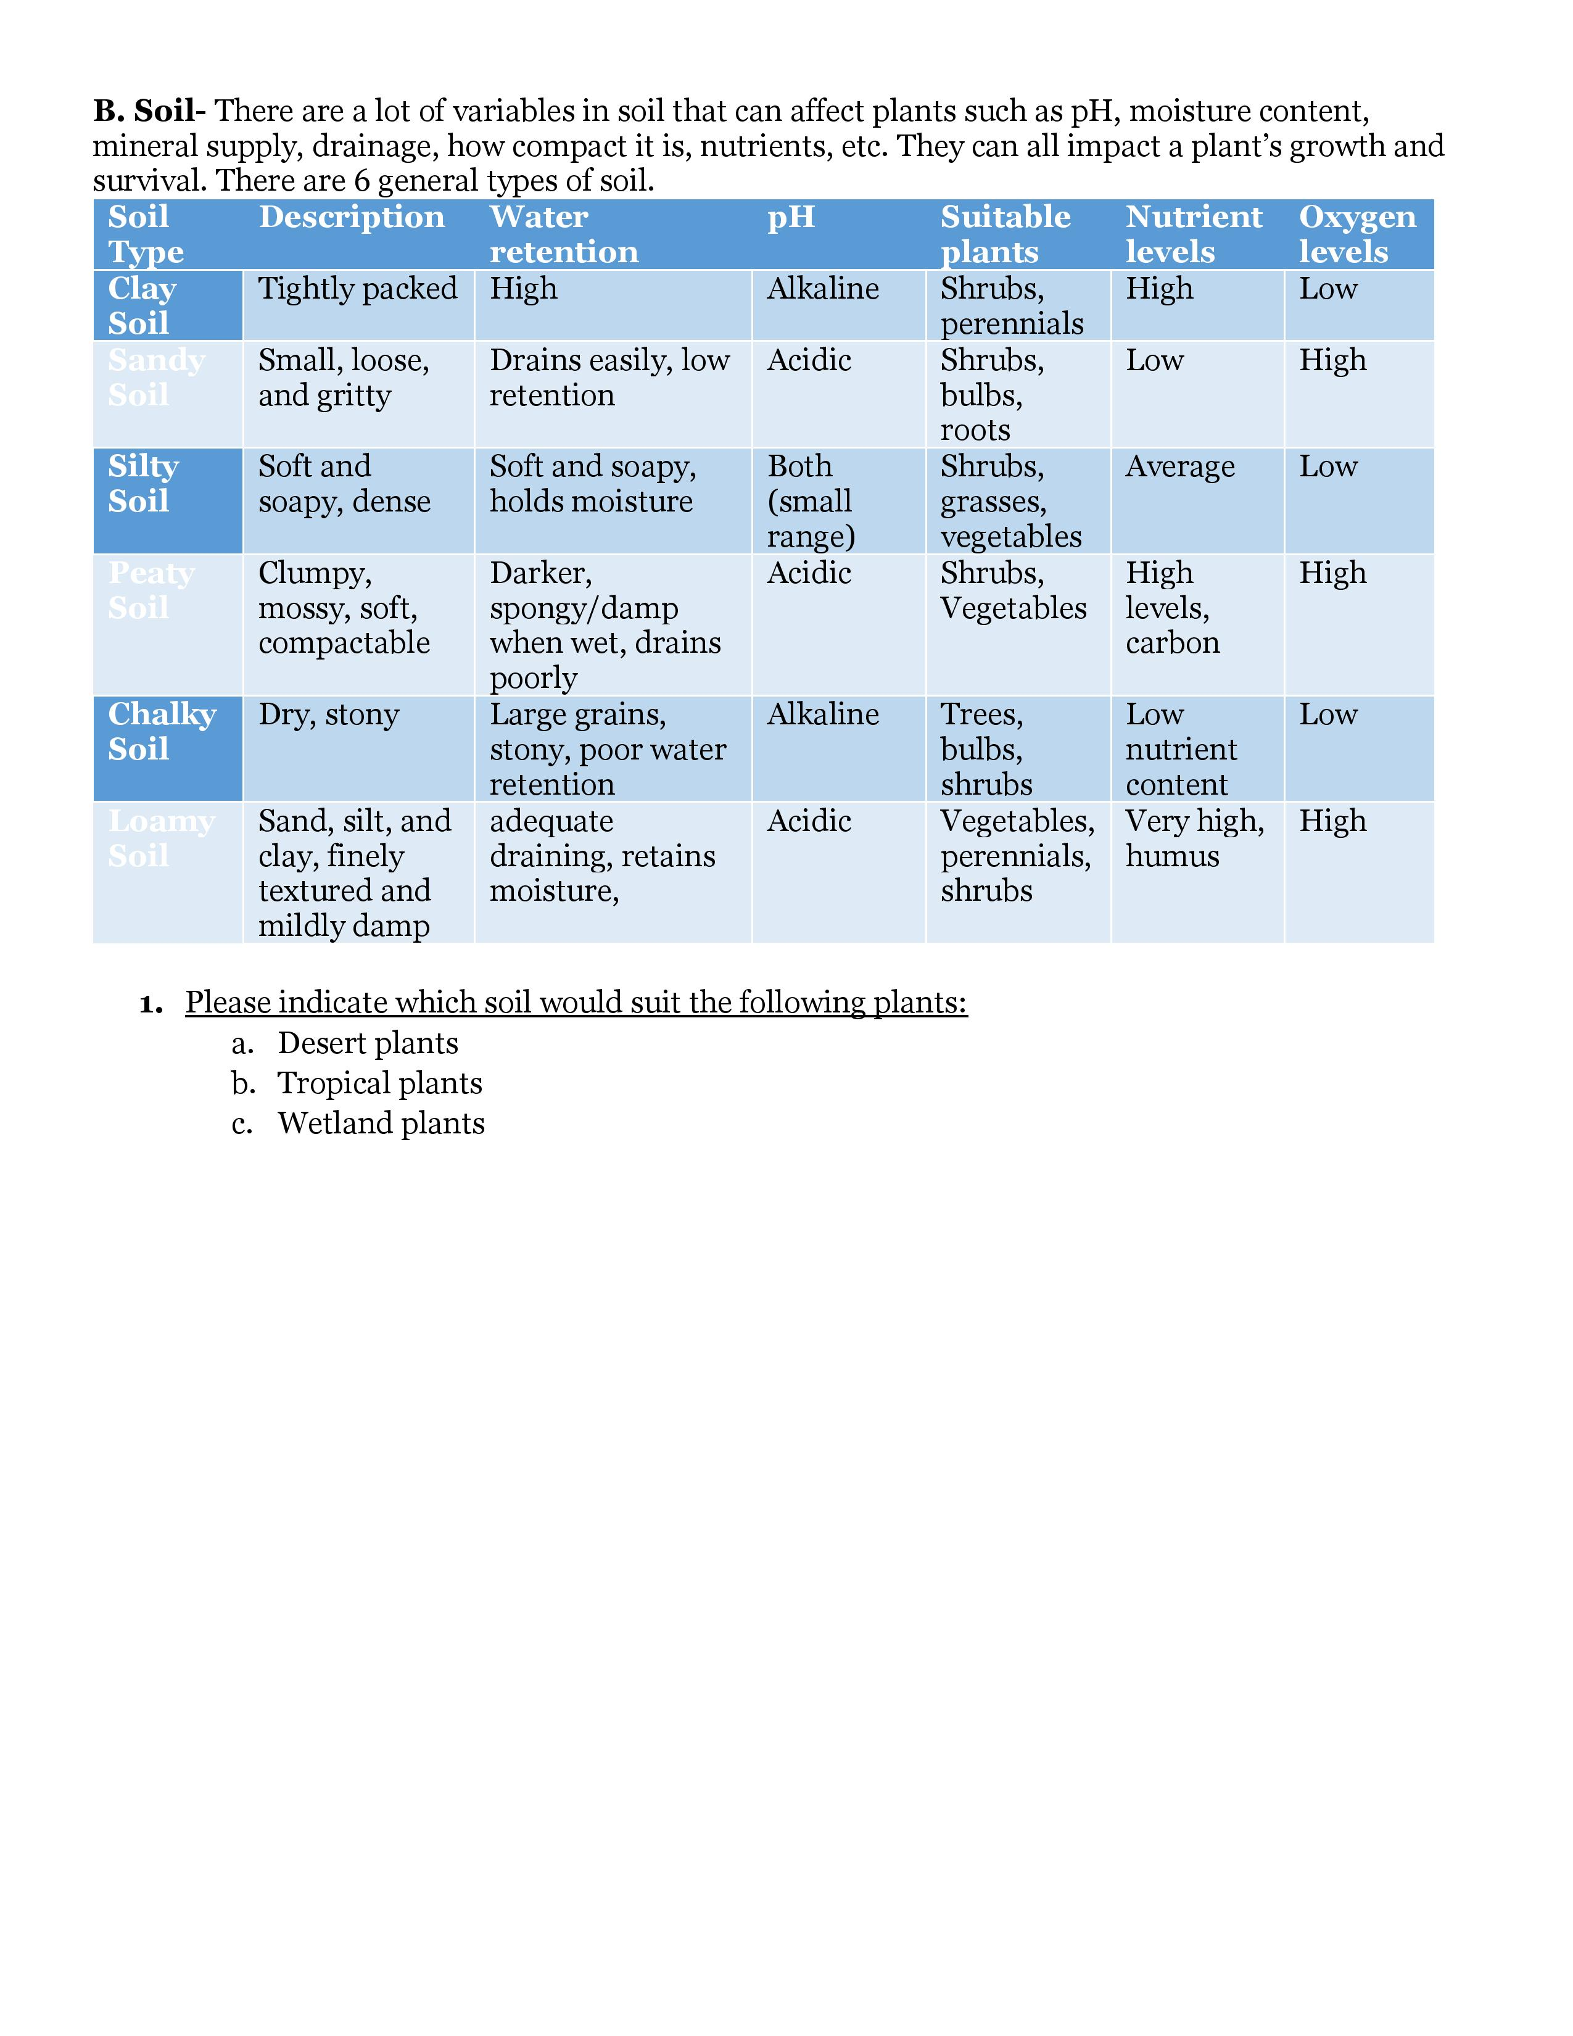
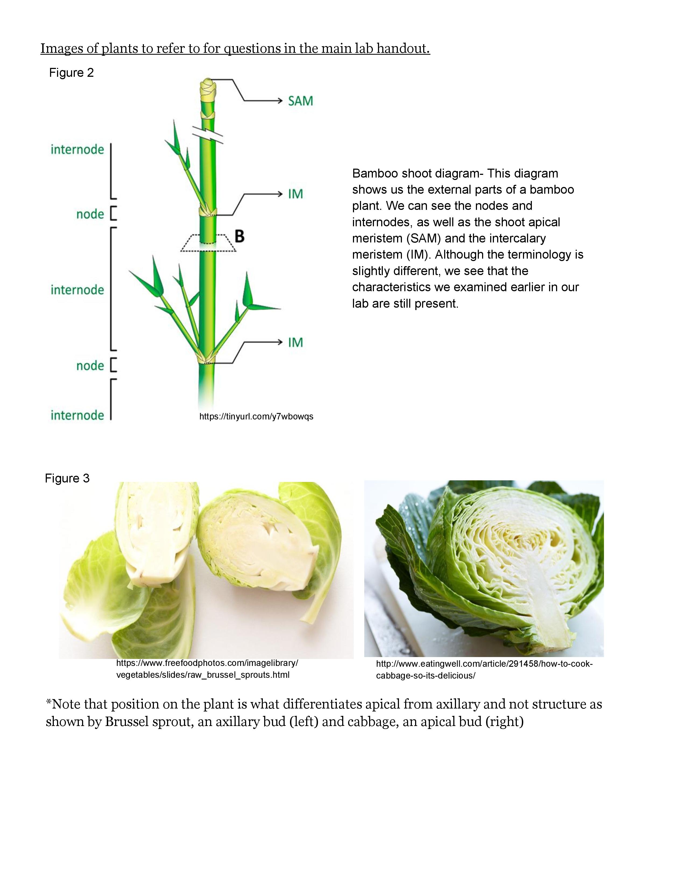
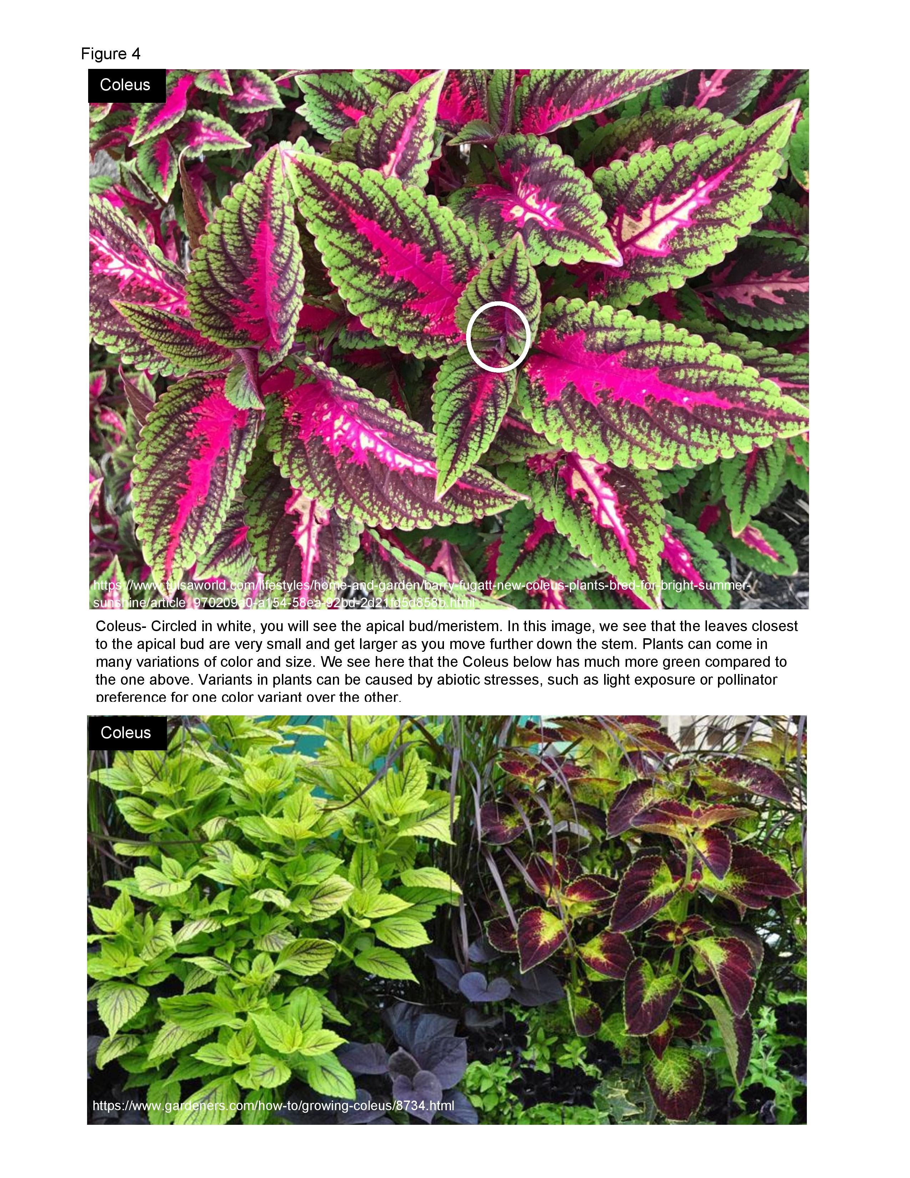
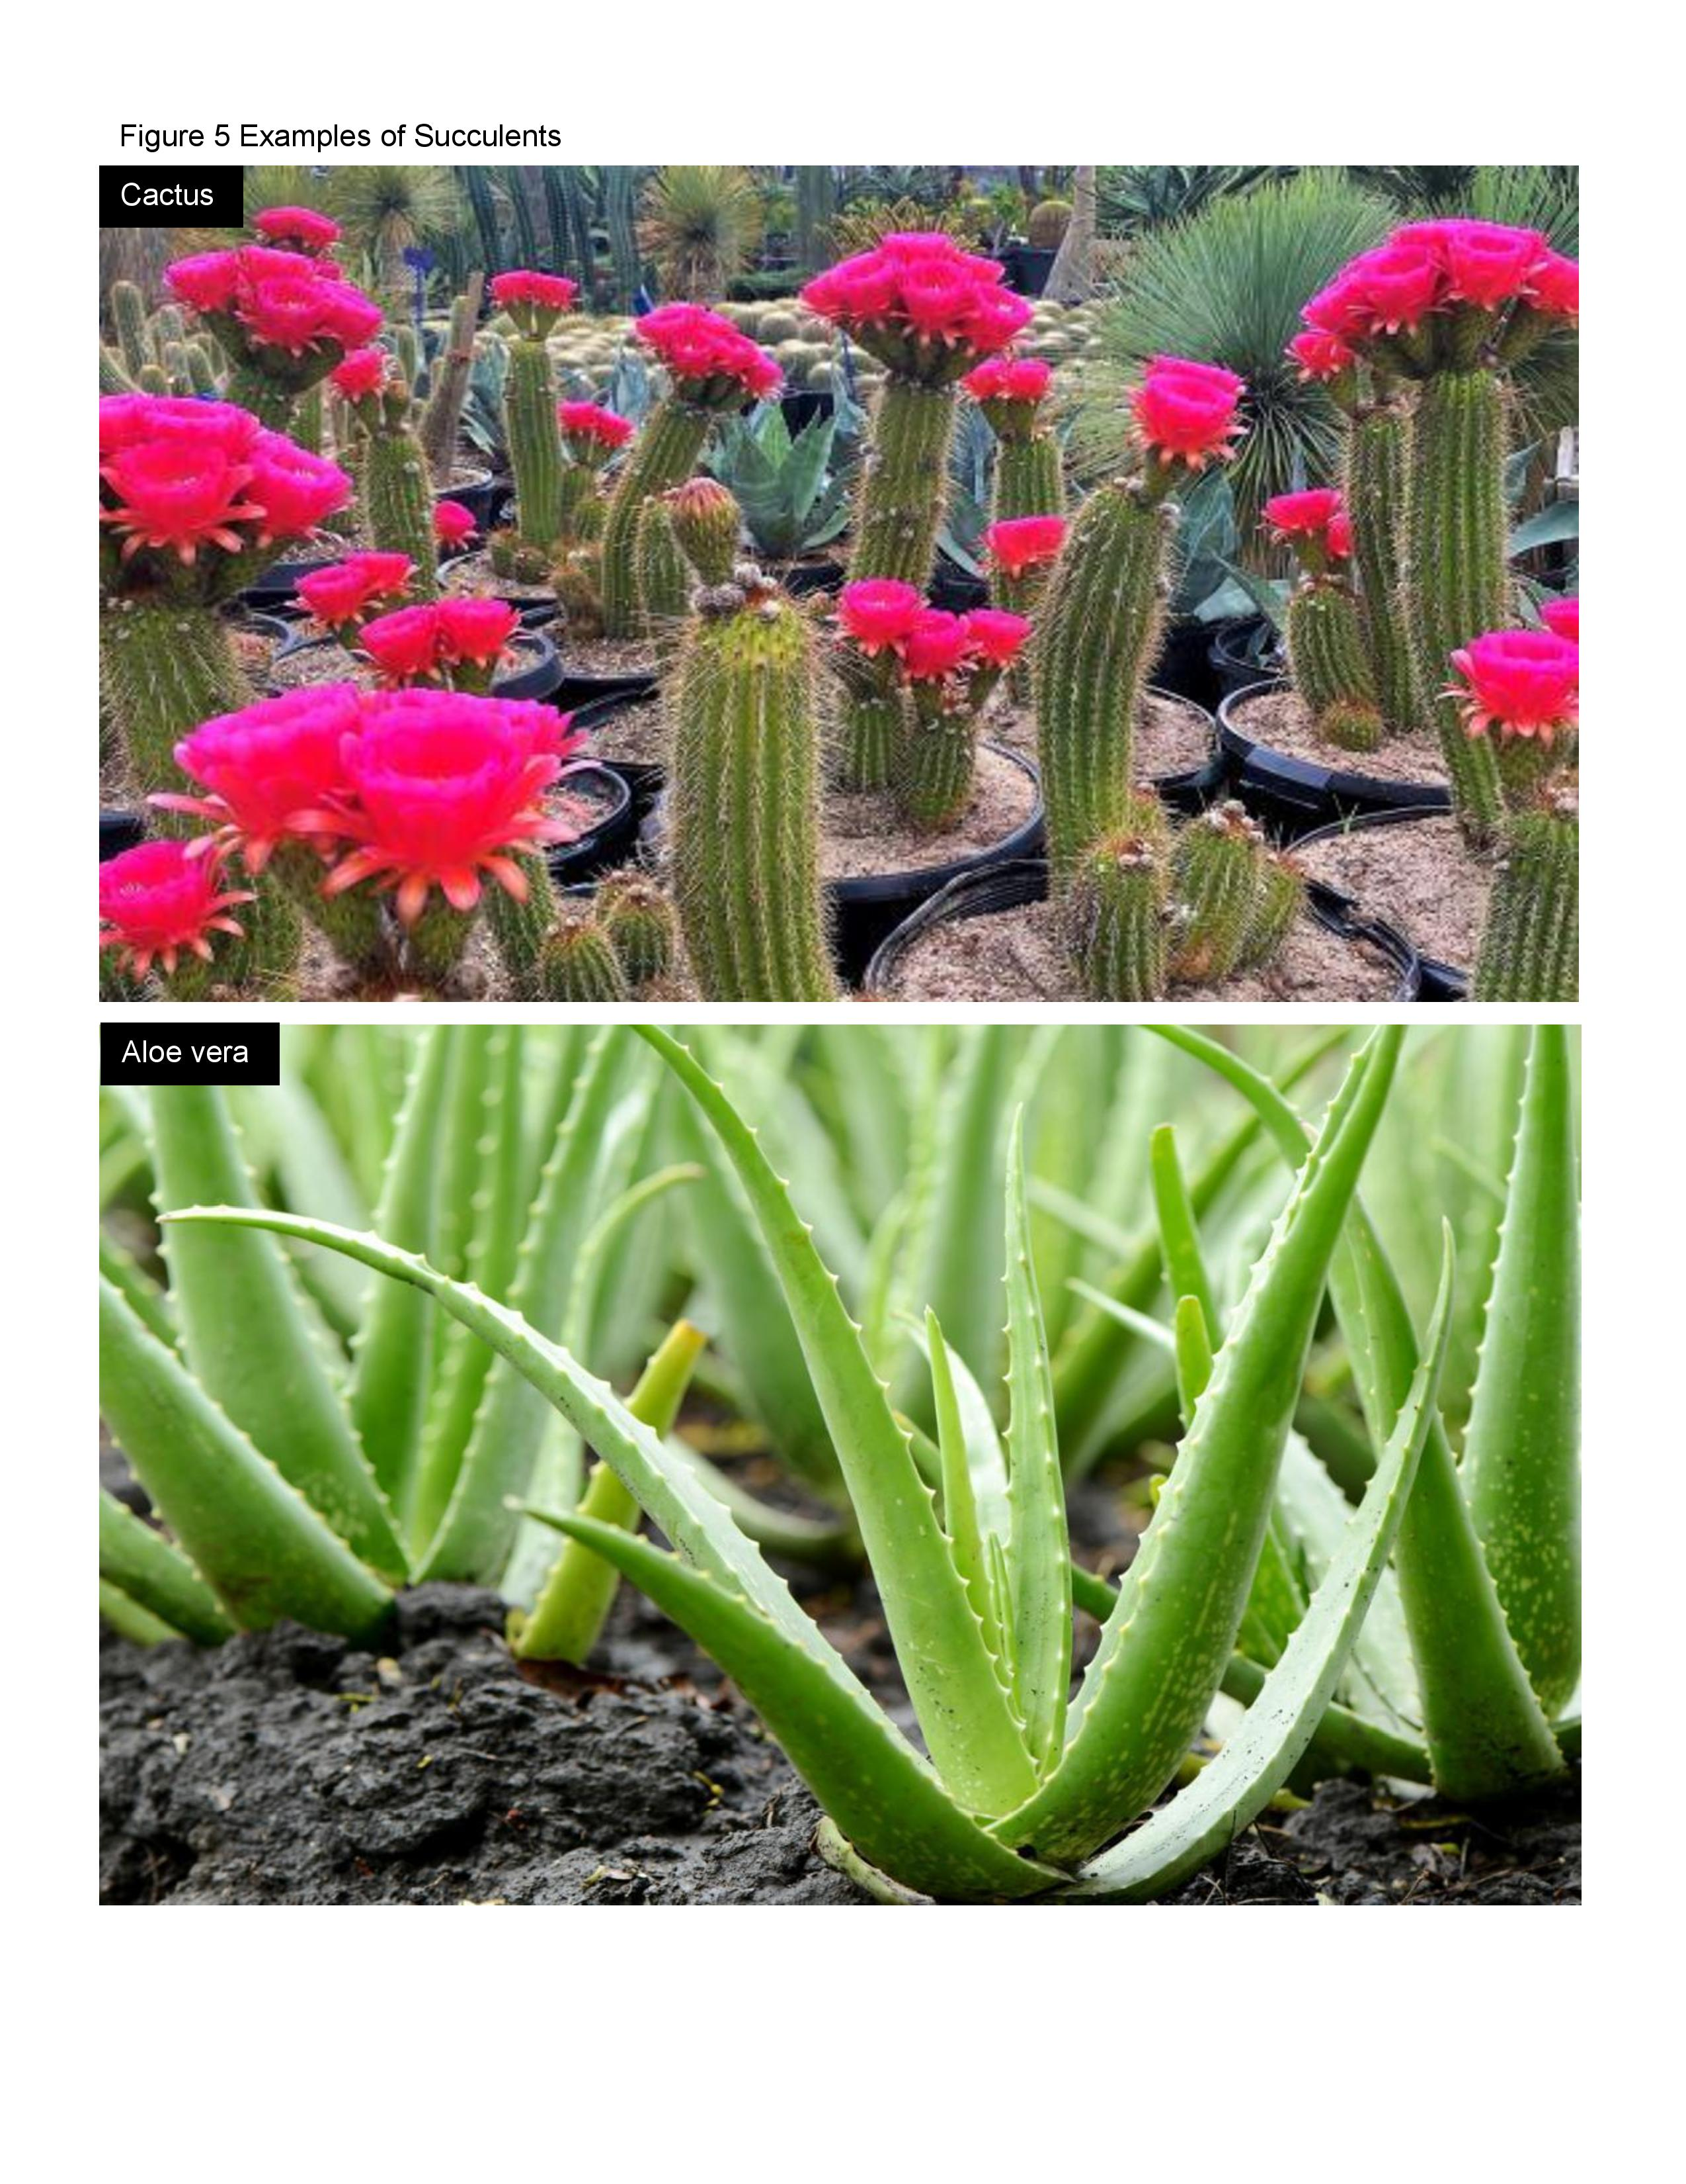
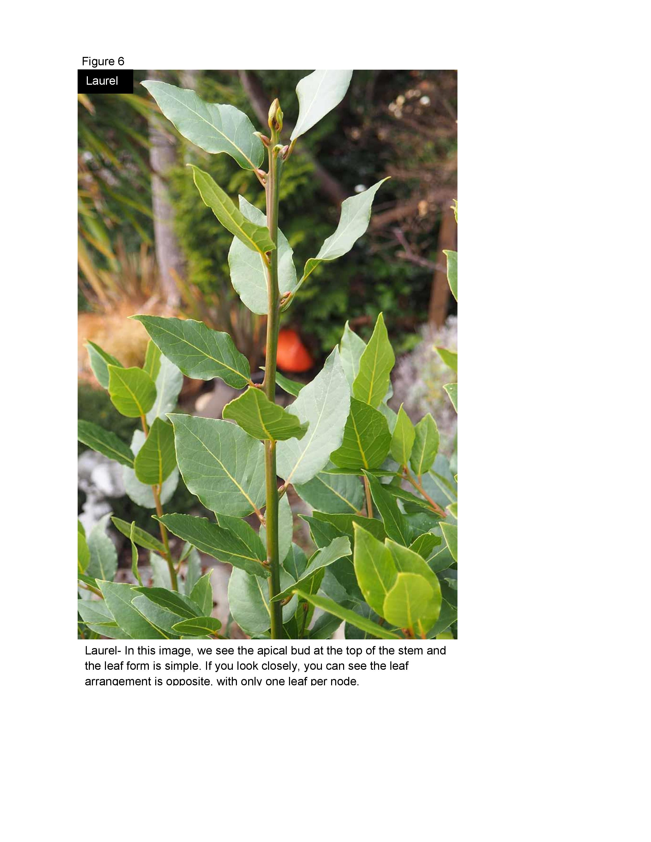
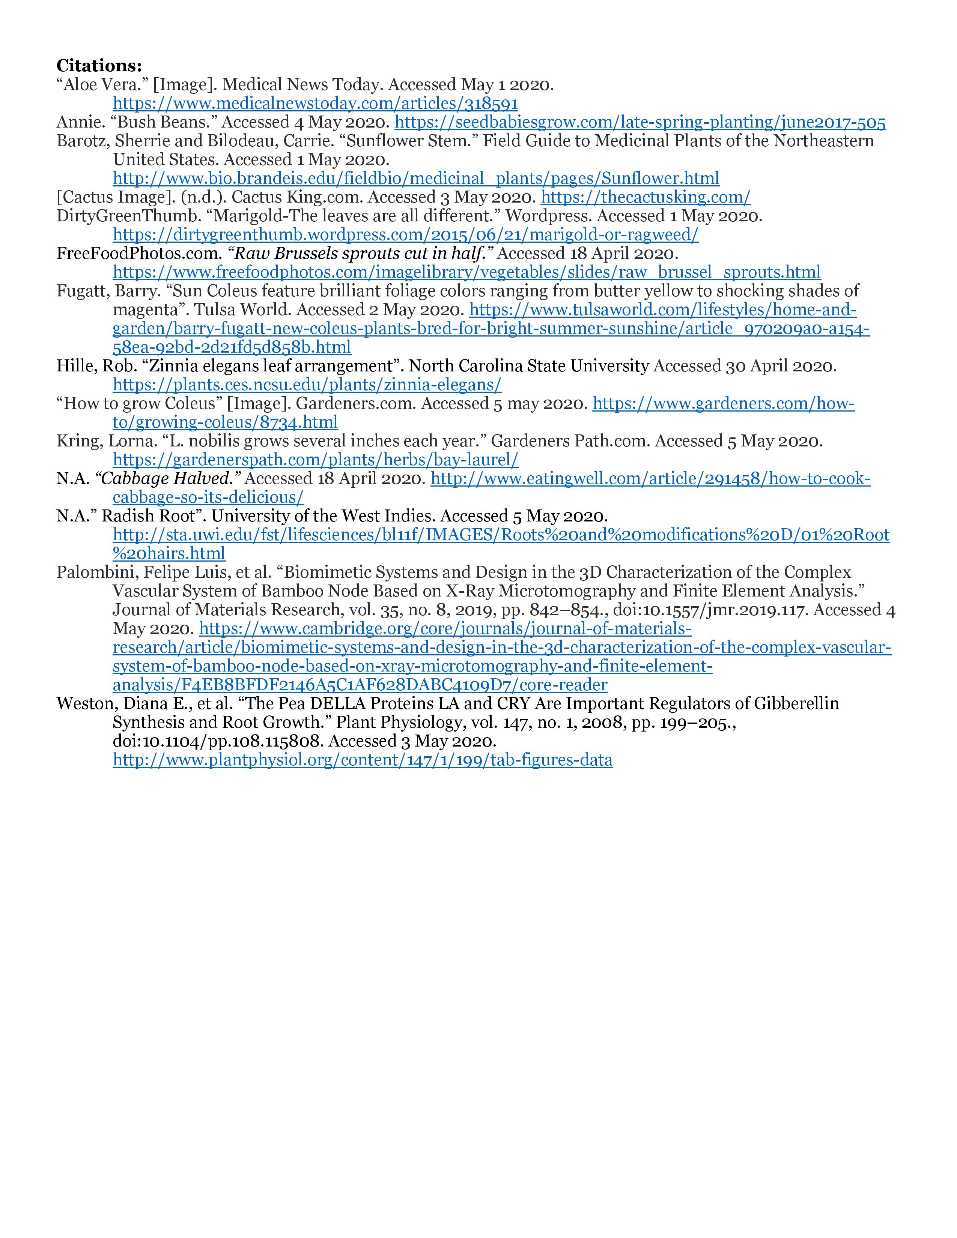
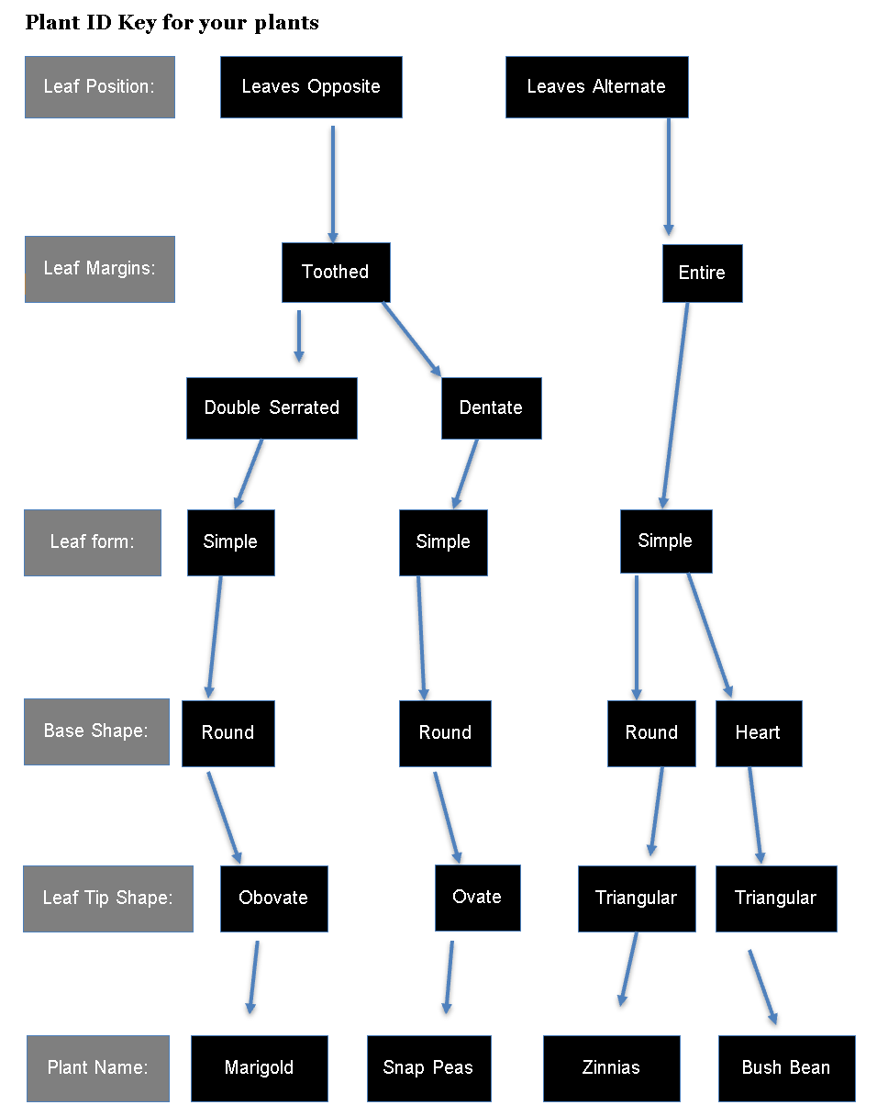
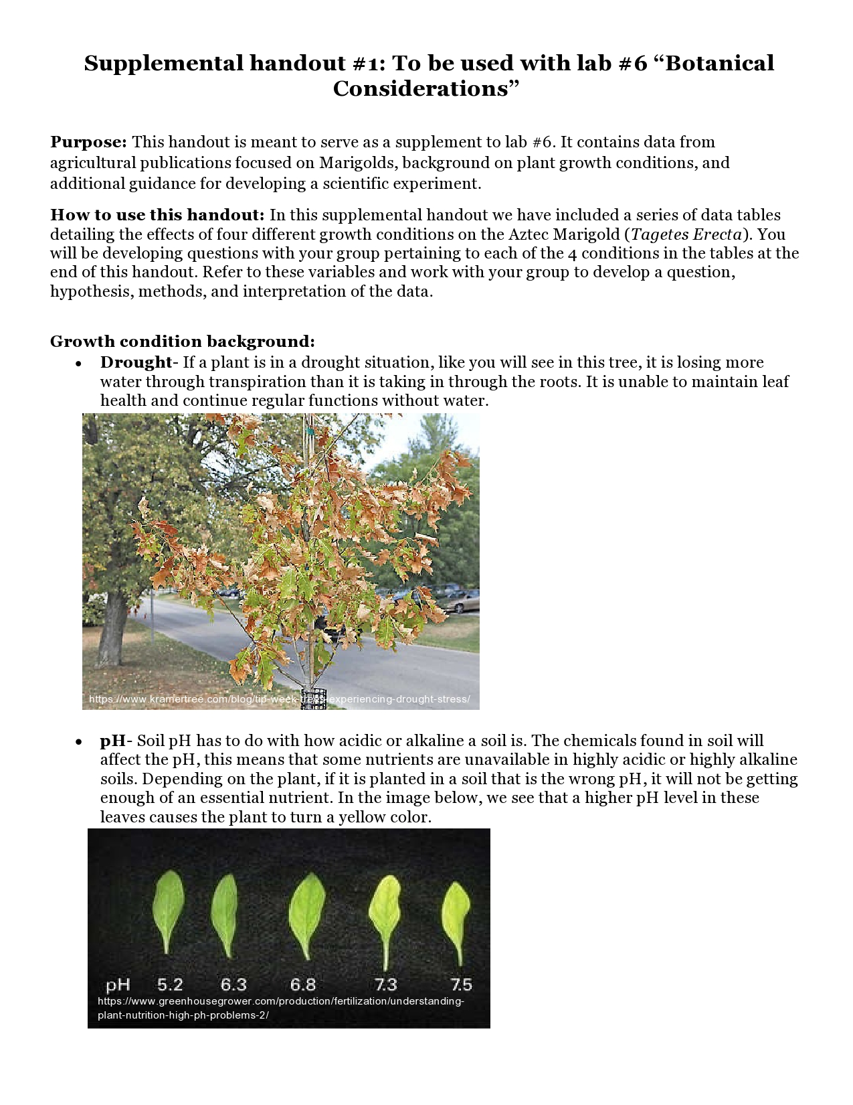
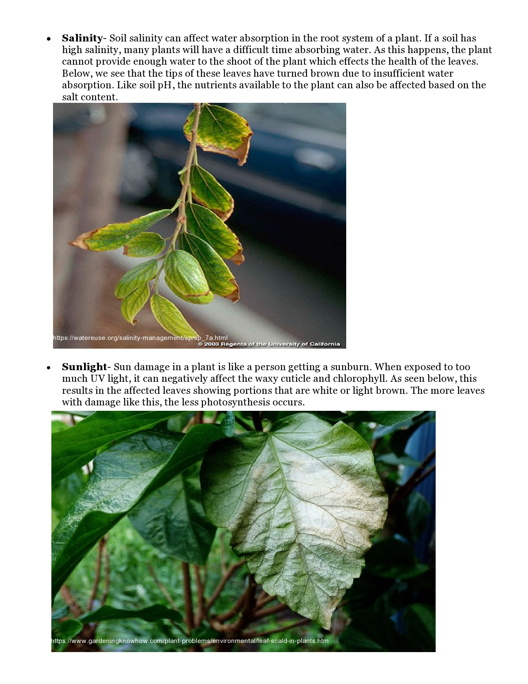
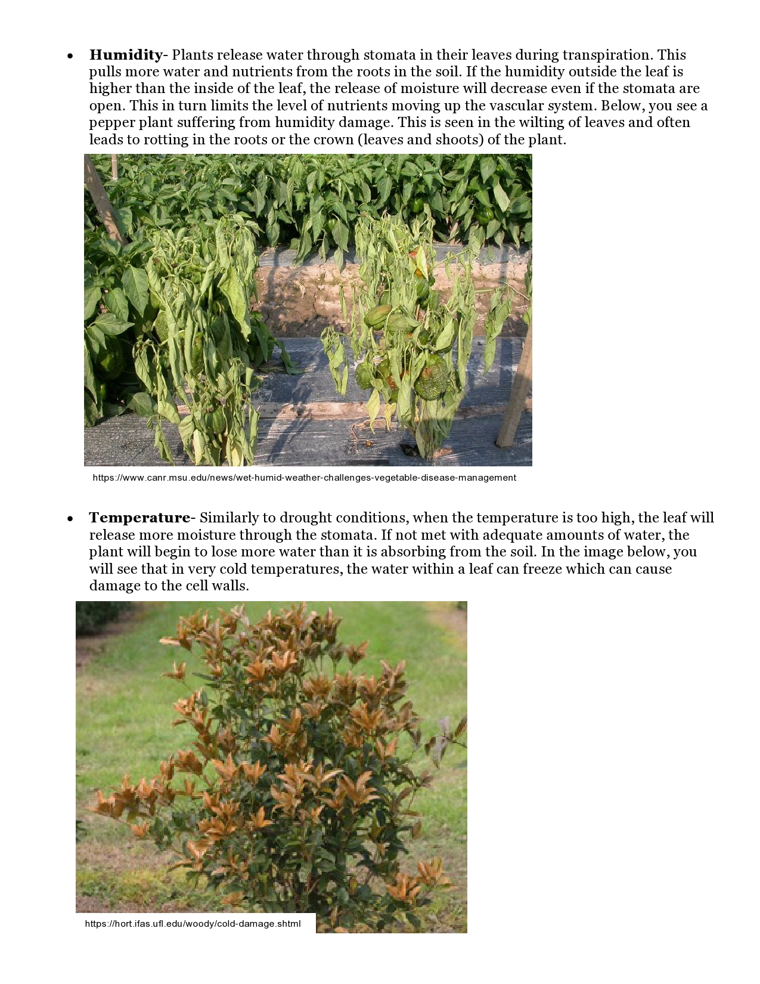
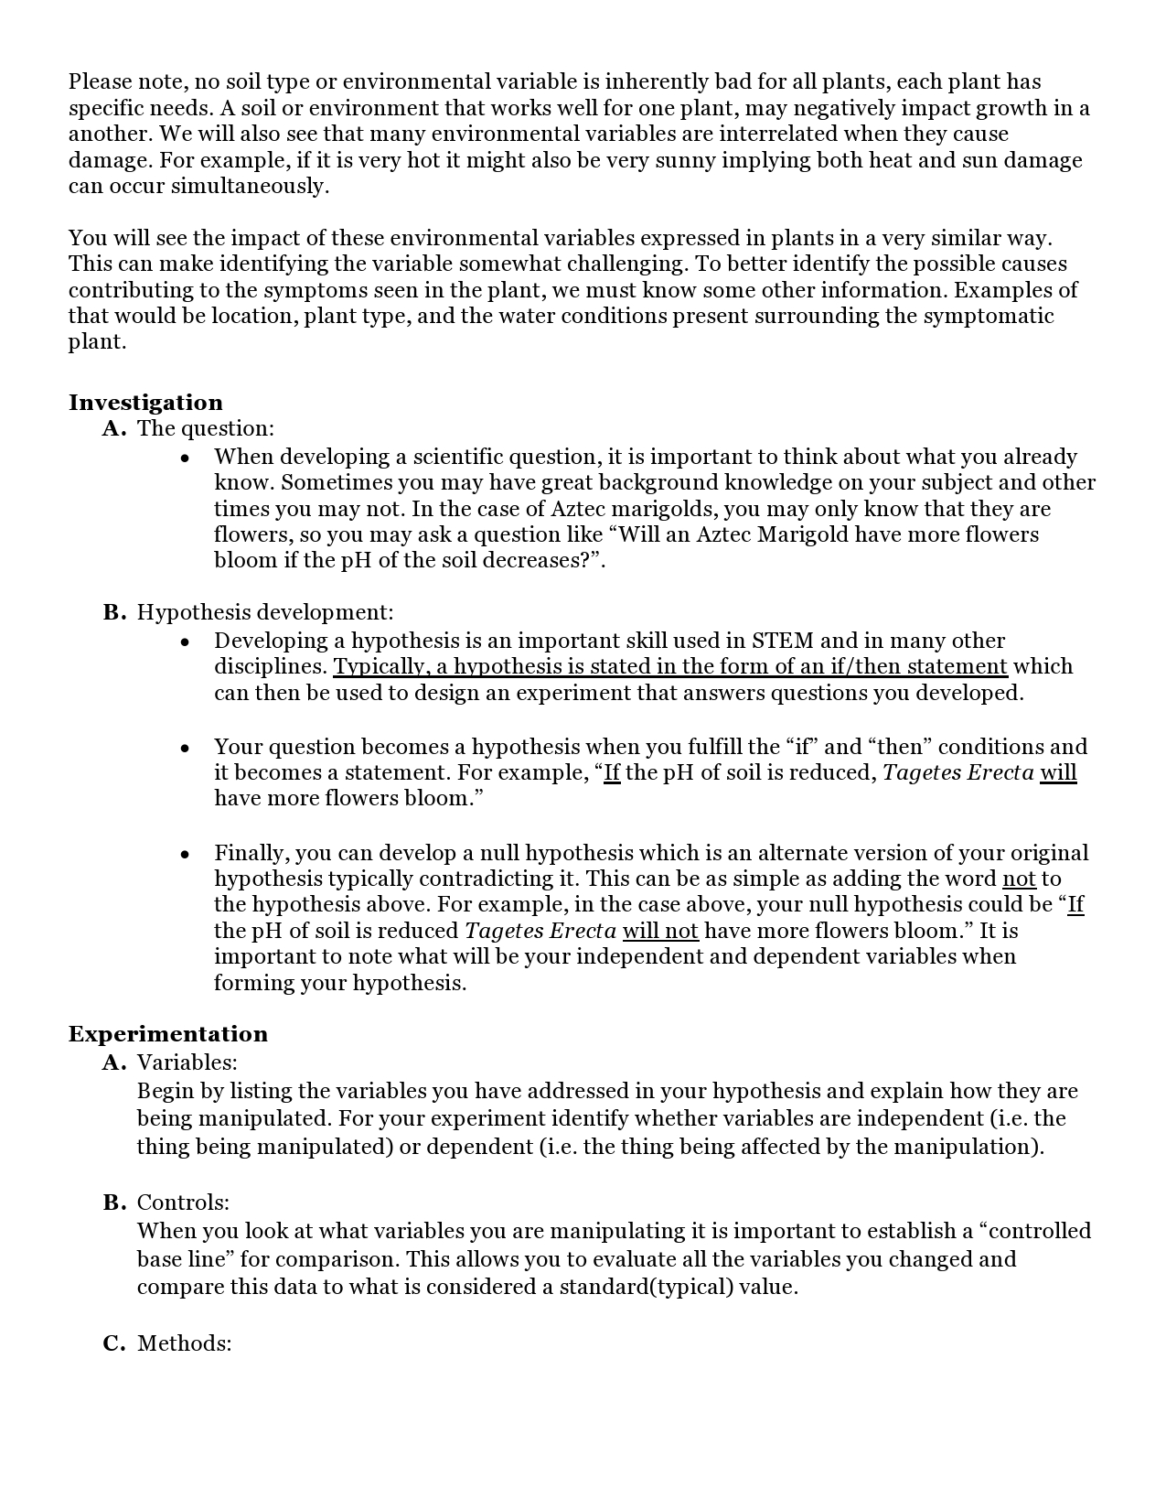
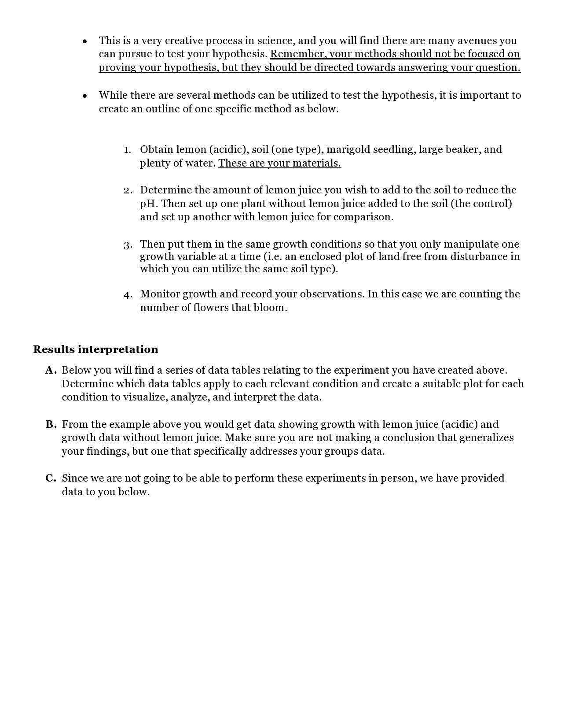
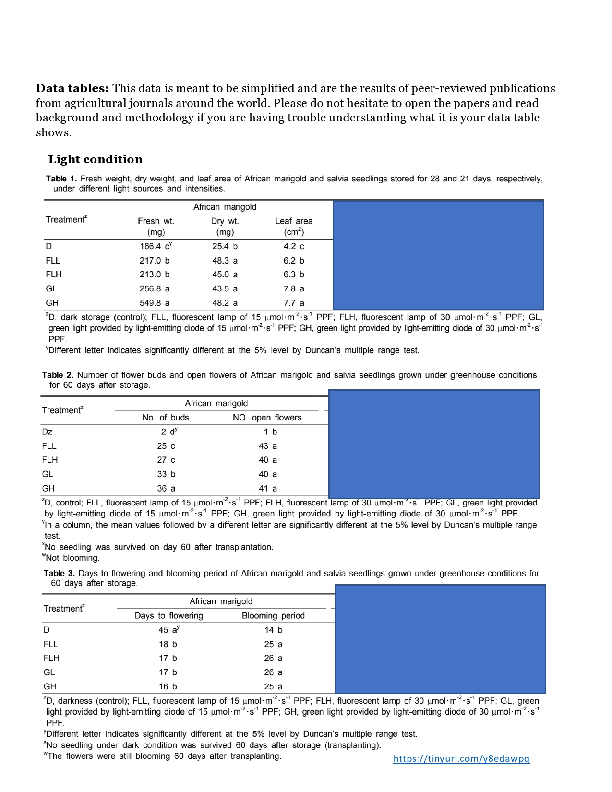
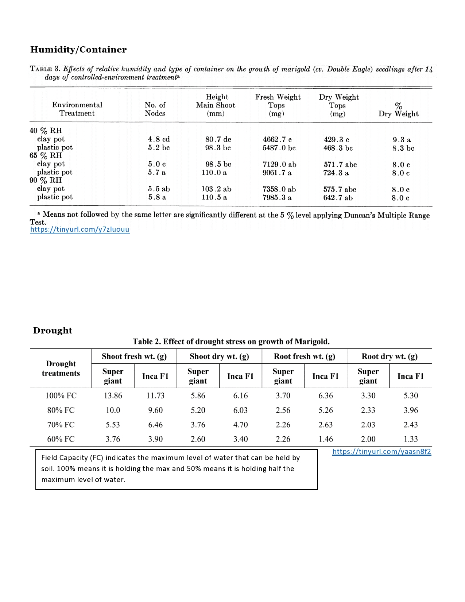
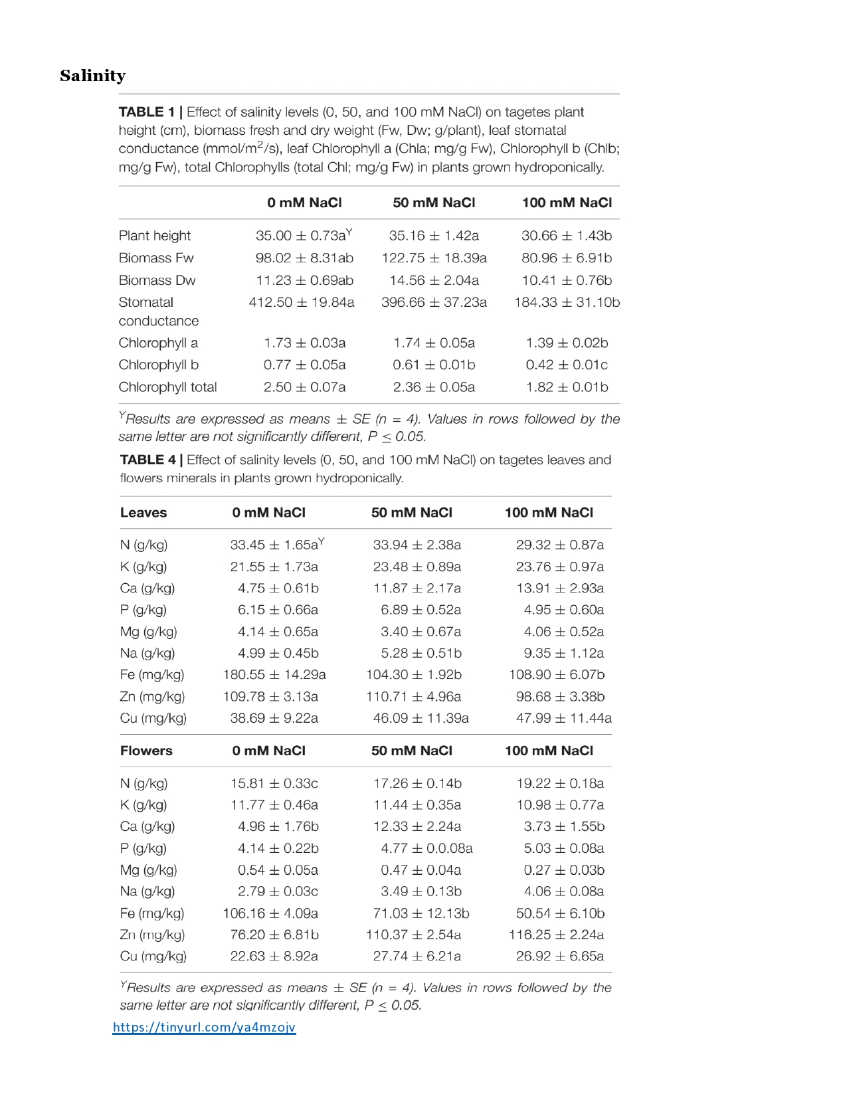
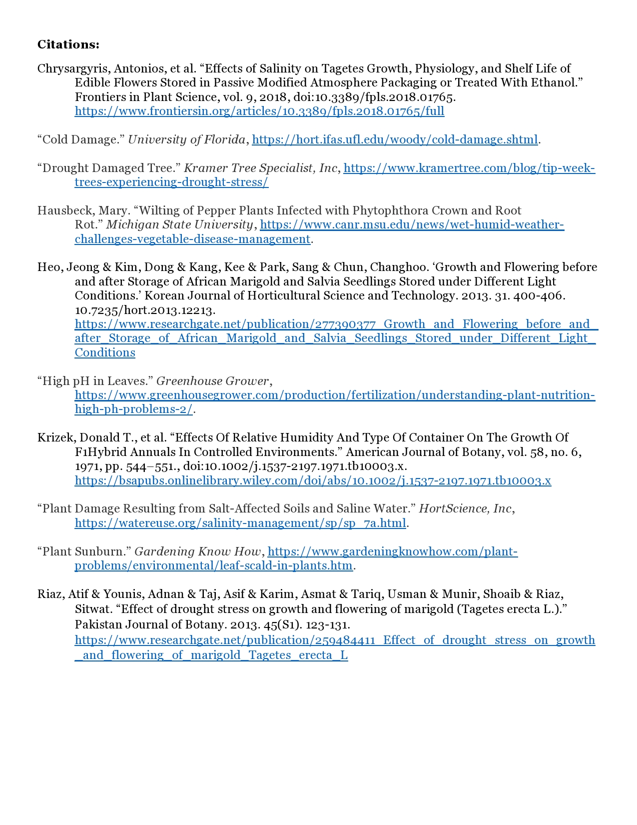
Applying plant biology to the development of science education and communication.
Sean Allen, Miranda Everett, Dr. Salwa Al-Noori
Introduction
Creative Process
Materials
Outcomes
Reflection
The goal of this independent study project is to integrate information learned through the Washington State University Extension Master Gardeners and adapt it to supplement in-lab and in-class learning for Dr. Al-Noori’s B BIO 220 plant unit. This includes plant identification, aspects of plant structure and function, properties of soils, and the impact of various conditions on plant growth. We will engage in the development of activities for students using published research on plant growth and conditions to facilitate learning. Finally, we wish to integrate new information from the master gardening program into the supplemental lab activities to determine the outcomes of incorporating this supplemental information into the lab component.
Objectives
Supplemental Handout # 1
Supplemental Handout #1
Challenges and opportunities for growth
Creating a plant identification key to further develop understanding of plant characteristics.
Develop a basic understanding of plant identification keys and their implementation in real-world scenarios.
Reinforcing skills needed to determinations about plant function based on external characteristics.
Discover how different soil varieties and characteristics affect plant growth.
Examining the effects of various environmental conditions on plant growth.
Engaging in experimental design and critical analysis.
Understand the physical signs and symptoms shown in a plant that has undergone the tested conditions.
Through grading student work we identified sections of our supplemental handout that were less effective in communicating the plant science concepts we were looking to convey.
Given the overall rate of student success on supplemental handout questions, we can infer that most students were able to grasp the concepts we introduced.
Adaptation of the supplements to zoom was a complicated. We had to provide the same challenges, faced in lab without a lab. Resulting in limited hands-on learning opportunities to reinforce supplement content
Through the grading process we encountered challenges regarding the flow of information regarding the soil component
Supplemental Handout #2
Our experience
Master Gardeners Program
(Miranda Everett)
Educational Component
(Sean Allen)
Supplement development
10 groups had issues listing what factors were being controlled (59%)
4 groups had issues developing a clear and concise hypothesis (24%)
We found most groups developed unique methodology based on specific examples provided to them from the supplemental handout.
Students were able to interpret data provided to them without over-extrapolation.
The detailed process of lab material formation and creation
Formation of learning objectives.
Developed a deeper understanding of introductory plant biology.
Utilizing wording, formatting, and presentation to develop methodology which can achieve successful student outcomes.
Approaches to engaging students in the presented material
Reinforced plant biology concepts while educating our peers.
Gained valuable insight into the discussion and presentation of plant biology from an educational perspective.
Learned the benefit of student discussion through prompts, questions and observation to promote cooperative learning
Overall
Reinforced the fundamentals of plant biology in both the students as well as in ourselves.
Explored new content which supplemented introductory biology education.
Gained valuable insight into educational skills.
The Master Gardeners Program is an intensive course on basic plant biology, plant identification, and plant-problem diagnosis.
The students in this program are also trained as community educators on these topics.
For this project I integrated and applied knowledge from the Master Gardeners Program into further developing my understanding of plant biology and community education.
I learned to facilitate discussions that focused on developing students’ understanding of plant biology.
My education has led me to develop a deeper interest in the educational components of introductory biology.
Working on this collaboration allows me to go beyond the scope of introductory biology education, both in terms of content and application.
This experience has provided me with new insight into science education and communication and deeper understanding of plant biology.
The Plant ID key went through several iterations of development. Initially the identifiers were listed, then adapted to a flowchart. We found the simplicity of the flowchart did not represent a conceptual challenge for students and developed a table instead.
Supplemental Handout #2
Data/results from agricultural studies and fundamentals of developing a scientific experiment were integrated to expand students conceptual understanding of experimental design.
Supplement integration in lab #7
Implementation
Concepts and materials from supplements were identified in the grading of Lab #7
A small portion of students identified plant structures, specifically axillary buds and leaf type (simple or compound) when looking at plant histology
Many students avoided overextrapolation of their observations which can indicate a metacognitive understanding a student's data/results/observations
The combination of these objectives led to:
The incorporation of scientific research and application of knowledge to further develop concepts and content in plant biology.
An understanding of how to best communicate this to a community of undergraduate students.
References
We developed a series of questions and prompts to engage students with supplemental handout material.
Encouraged ongoing dialogue between students and ourselves to create an open and communicative learning environment.
We implemented peer-based learning by utilizing breakout rooms in Zoom conferencing software.
Discussion of real-world scenarios to the application of experimental methodology in plant biology.
Anderson, L. W., & Krathwohl, D. R. (2001). A taxonomy for learning, teaching, and assessing: A revision of Bloom's taxonomy of educational objectives. New York: Longman.
Antonelli, Art, et al. Master Gardener Manual. Washington State University Extension, 2010.
Hershey, D. R. (1992). Making Plant Biology Curricula Relevant. BioScience, 42(3), 188–191. doi: 10.2307/1311824
Uno, G. E. (2009). Botanical literacy: What and how should students learn about plants? American Journal of Botany, 96(10), 1753–1759. doi: 10.3732/ajb.0900025

Slide 2
Master Gardeners Program
(Miranda Everett)
Educational Component
(Sean Allen)
The Master Gardeners Program is an intensive course on basic plant biology, plant identification, and plant-problem diagnosis.
The students in this program are also trained as community educators on these topics.
For this project I integrated and applied knowledge from the Master Gardeners Program into further developing my understanding of plant biology and community education.
I learned to facilitated discussions that focused on developing students’ understanding of plant biology.
My education has led me to develop a deeper interest in the educational components of introductory biology.
Work on this collaboration has provided me the opportunity to engage in published research on education in both plant science and biology as whole
This experience provided me with the opportunity to apply educational research into my own biology education to advance my own learning.
The combination of these objectives led to:
The incorporation of scientific research and application of knowledge to further develop concepts and content in plant biology.
An understanding of how to best communicate this to a community of undergraduate students.

Slide 3

Objectives
Develop a basic understanding of plant identification keys and their implementation in real-world scenarios.
Utilize a plant identification key to further develop understanding of plant characteristics.
Reinforcing skills needed to make determinations about plant function based on external characteristics.
Discover how different soil varieties and characteristics affect plant growth.
Examining the effects of various environmental conditions on plant growth.
Engaging in experimental design and critical analysis.
Understand the physical signs and symptoms shown in a plant that has undergone the tested conditions.

Slide 4

Supplement development
The Plant ID key went through several iterations of development. Initially the identifiers were listed, then adapted to a flowchart. We found the simplicity of the flowchart did not represent a conceptual challenge for students and developed a table instead.
Data/results from agricultural studies and fundamentals of developing a scientific experiment were integrated to expand students conceptual understanding of experimental design.

Slide 5
Implementation
Prior to lab we had to consolidate and expand our own plant biology knowledge through published literature.
We developed a series of questions and prompts to engage students with supplemental handout material.
We implemented peer-based learning by utilizing breakout rooms in Zoom conferencing software.
Discussion of real-world scenarios to the application of experimental methodology in plant biology.

Slide 6
Supplement handout #1 for Lab #5-Plant structure and function

Slide 9
Supplemental handout #2 for Lab #6-Botanical Considerations

Slide 12
Supplemental Handout #1 Outcomes
Through grading student work we identified sections of our supplemental handout that were less effective than expected in communicating the plant science concepts we were looking to convey.
Given the overall rate of student success on supplemental handout questions, we can infer that most students were able to grasp the concepts we introduced.

Slide 13
Supplemental Handout #2 Outcomes
10 groups had issues listing what factors were being controlled (59%)
4 groups had issues developing a clear and concise hypothesis (24%)
We found most groups developed unique methodology based on specific examples provided to them from the supplemental handout.
Students were able to interpret data provided to them without over-extrapolation.

Slide 14
Challenges and opportunities for growth
Adaptation of the supplements to Zoom presented a unique set of obstacles for us. We had to provide the same challenges, faced in lab without a lab. Resulting in limited hands-on learning opportunities to reinforce supplement content.
Through the grading process we encountered challenges regarding the flow of information regarding the soil component

Slide 15
Our experience
The detailed process of lab material formation and creation
Formation of learning objectives.
Developed a deeper understanding of introductory plant biology.
Utilizing wording, formatting, and presentation to develop methodology which can achieve successful student outcomes.
Approaches to engaging students in the presented material
Reinforced plant biology concepts while educating our peers.
Gained valuable insight into the discussion and presentation of plant biology from an educational perspective.
Learned the benefit of student discussion through prompts, questions and observation to promote cooperative learning
Overall
Reinforced the fundamentals of plant biology in both the students as well as in ourselves.
Explored new content which supplemented introductory biology education.
Gained valuable insight into educational skills.

